Slide 1
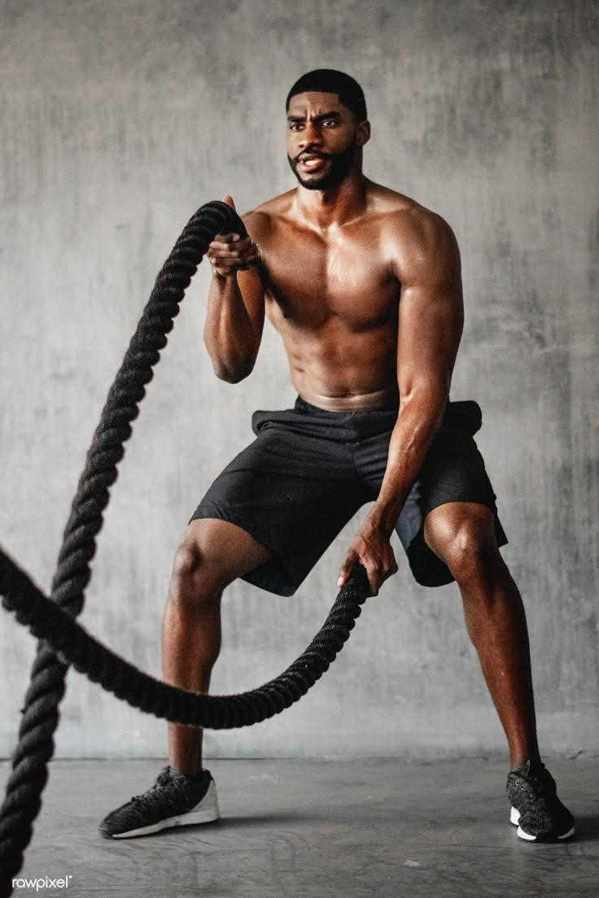
AI-Powered Fitness & Lifestyle Web App : Fit-Sync AI
Team ImpactTech presents a revolutionary AI-driven fitness and lifestyle web app. This presentation covers project goals, users, requirements, and sprint planning. Learn how our app personalizes fitness and lifestyle recommendations.
By : Pranav Bhatia, Sourav Shetye, Nick Boyle, Devaang Nadkarni
Notes:
Hey everyone! We’re Team ImpactTech, and today we’re excited to walk you through our project—Fit-Sync AI, an AI-powered fitness and lifestyle web app. We’ll cover what the app does, who it’s for, our development plan, and what we’ve learned so far as a team. Let’s jump right in!”

Slide 2

Project Goals & Objectives
Personalized Recommendations
Improved Health Outcomes
Provide tailored workout and nutritional plans using AI. Boost active users by 40% within three months.
Offer data-driven insights. Aim for 25% of users reporting better fitness in six months.
Scalable Platform
Adapt to user needs. Incorporate new AI tech, achieving a high Net Promoter Score (NPS) of 70+.
Notes:
Our goal is simple—make fitness more personal, data-driven, and accessible for everyone. We’re using AI to recommend custom workouts and meal plans. We hope to boost user engagement by 40% in three months, and we’d love to see at least 25% of users say they’re seeing real fitness improvements within six months. Also, we’re building the app to grow over time—scalable, flexible, and aiming for a high user satisfaction score

Slide 3
Target Users & Personas
Health-Conscious Millennials
Tech-Savvy Individuals
Ages 25-40 seeking personalized guidance. "Sarah," a busy professional improving fitness and nutrition.
Ages 18-24 interested in AI fitness solutions. "David," a college student tracking fitness with wearables.
We focus on market research to understand user demographics and desired features.
Notes:
So, who’s this app really for? First, we’ve got Sarah, a busy millennial who wants a personalized guide to stay fit without spending hours figuring it out. Then there’s David, a college student into wearables and tech—he wants AI to do the heavy lifting. We’ve done some research and found that these kinds of users are really looking for something simple, smart, and supportive.

Slide 4
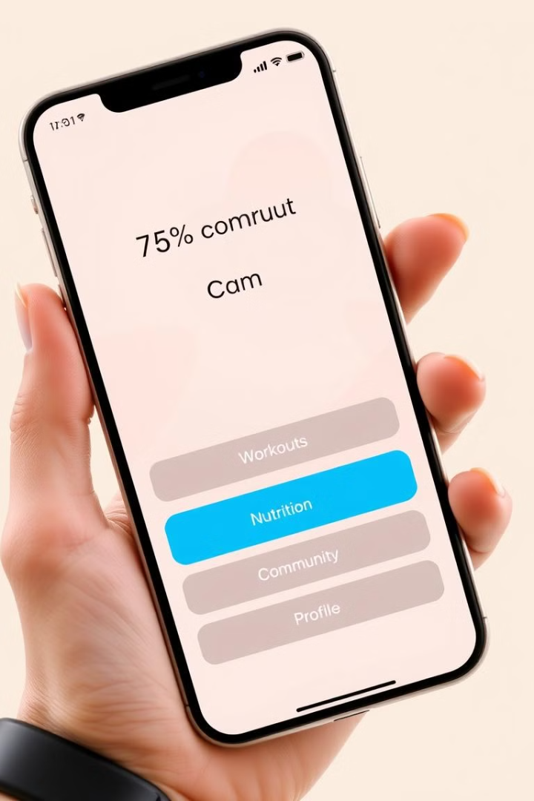
Functional Requirements
Secure Authentication
AI Recommendations
Multi-factor login/registration.
Personalized workout plans and tips.
Progress Tracking
Monitor fitness metrics.
The app integrates offers social features, and ensures data privacy with GDPR and CCPA compliance.
Notes:
Let’s talk features. First, we’ve built in secure login—multi-factor authentication to keep accounts safe. Then there’s the core of the app—AI-powered workout and meal recommendations. And of course, users can track their progress, get feedback, and adjust goals on the fly. It’s all wrapped with social features and strong privacy standards like GDPR and CCPA.

Slide 5




Non-Functional Requirements
Performance
Fast loading times (under 3 seconds), Google PageSpeed Insights score > 85.
Scalability
Handle concurrent users without performance drops, tested with simulated traffic.
Security
Protection against OWASP Top Ten vulnerabilities, regular audits.
The app offers high uptime, robust error handling, and adheres to WCAG guidelines.
Notes:
On the performance side, we want the app to load in under 3 seconds—because nobody likes waiting. We’ve tested it to handle lots of users at once, so it won’t crash if we go viral. Security is a big deal too—we’re actively protecting against common vulnerabilities. And we’re committed to making it accessible for everyone, including those with disabilities.

Slide 6

Product Backlog & Prioritization
Key Features
1
Prioritized by user value and feasibility (MoSCoW method).
2
User Stories
Clear format to define needs. "Track daily calorie intake to monitor my diet."
Task Breakdown
3
Detailed breakdown into manageable tasks.
Estimation uses story points and sprint velocity to track progress.
Notes:
We broke our features down using the MoSCoW method—basically, what we must, should, could, and won’t build right now. We created user stories like, ‘Track daily calories’ to make sure we’re building what users actually need. And for each feature, we’ve estimated effort using story points so we can plan sprints more effectively

Slide 7




Sprint Planning & Execution
Sprint Goals
Aligned objectives for each sprint.
Sprint Backlog
Selection of user stories and tasks.
Daily Stand-ups
Track progress and identify roadblocks.
Sprint reviews demonstrate completed features. Sprint retrospectives improve future sprints.
Notes:
Our development is broken into sprints—short cycles where we focus on building specific features. Each sprint has clear goals, and we do daily check-ins to stay on track. At the end, we review what we’ve built and talk about what went well and what didn’t. This helps us get better with each sprint.

Slide 8
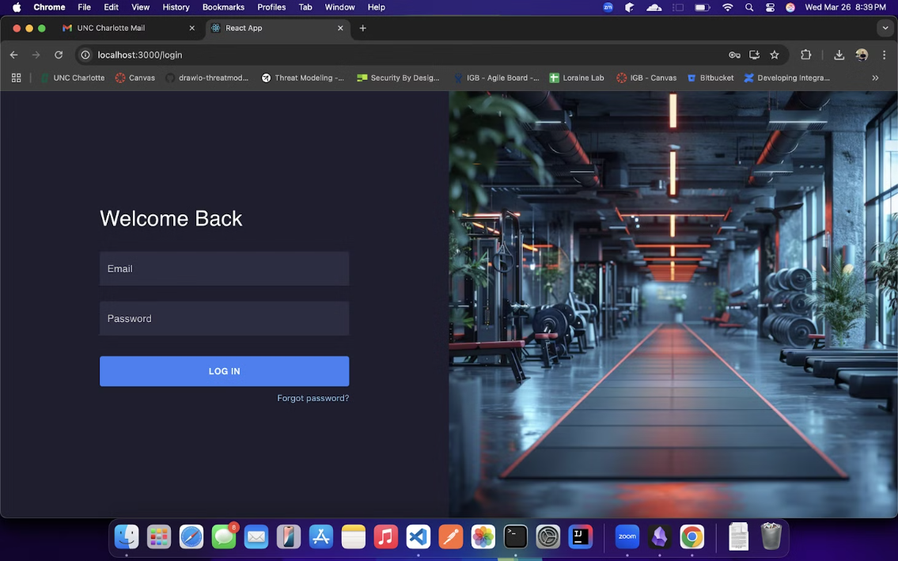
Login Page
Notes:
Here are some early UI sketches. The login page is simple and clean—get in fast, but securely.

Slide 9
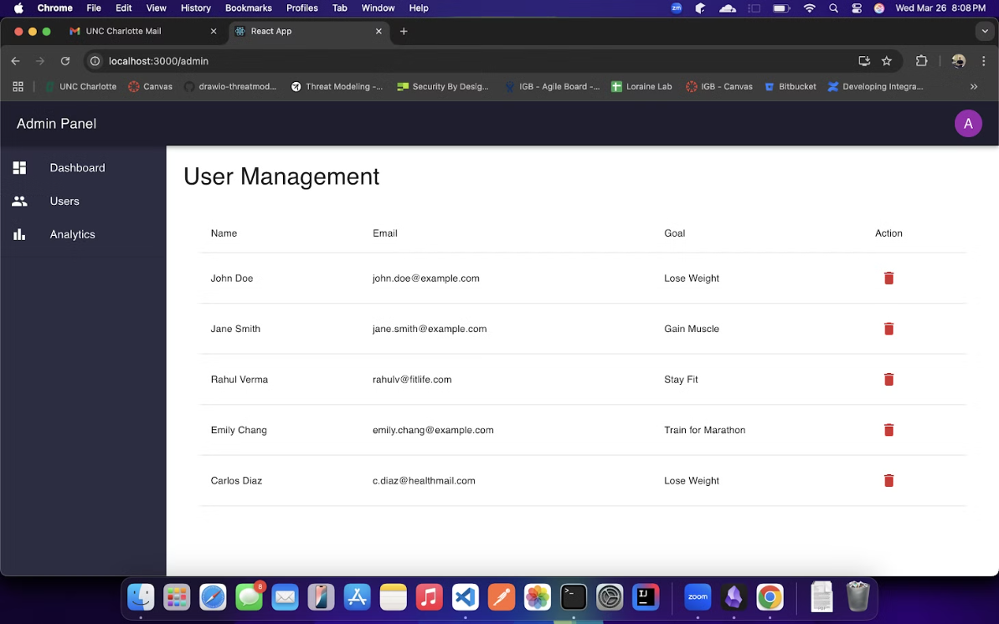
Admin Dashboard
Notes:
The admin dashboard gives us a bird’s-eye view to manage users and features

Slide 10
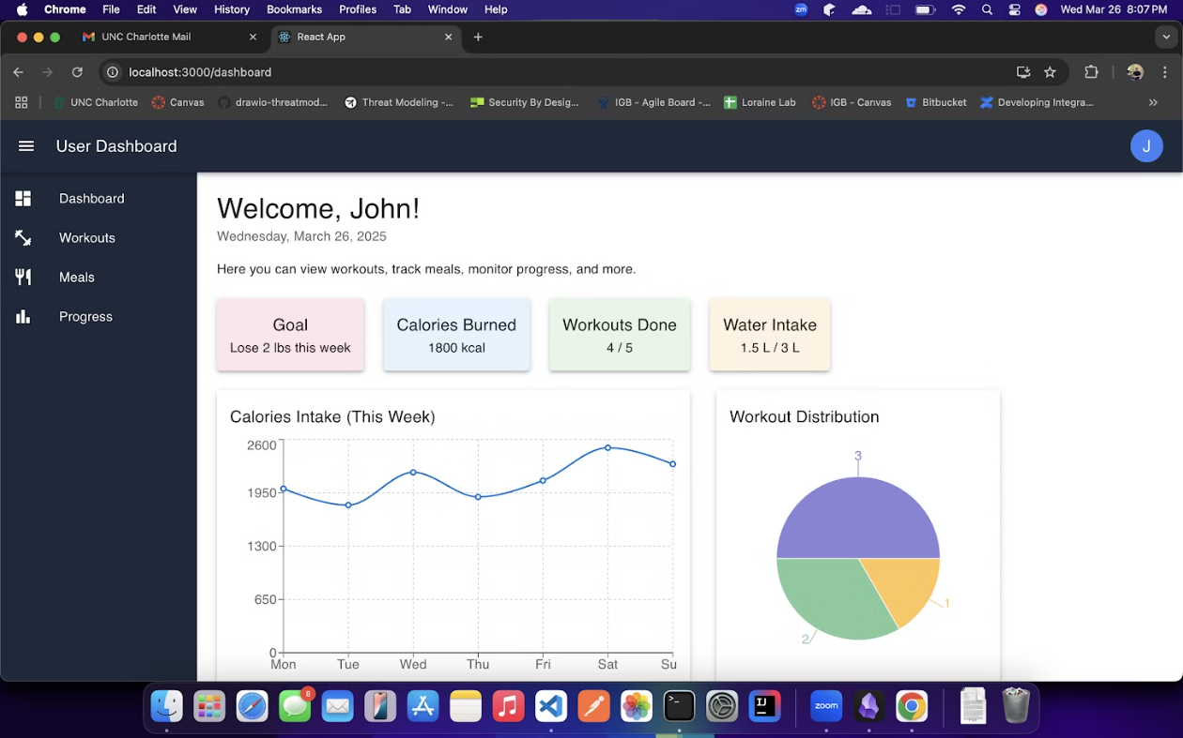
User Dashboard
Notes:
And the user dashboard is where the magic happens—diet plans, workouts, progress charts, and more. We designed everything to be super intuitive and user-friendly

Slide 11



Lessons Learned: Teamwork & Communication
1
Collaboration
2
Communication
3
Improvement
Teamwork requires shared responsibility and support. Communication needs effective channels and clear documentation. Continuous improvement reflects past experiences.
Notes:
Working as a team has taught us a lot. First, we learned that collaboration means being there for each other—even outside of our assigned roles. Second, communication is everything. We made sure to have clear notes, regular check-ins, and shared docs. And third, improvement is ongoing. Every meeting taught us something new—whether it was about the tech or about how we work as a group.

